Slide 1
What is Databricks SQL?
The Azure Databricks Lakehouse Platform provides a complete end-to-end data warehousing solution. The Databricks Lakehouse Platform is built on open standards and APIs. The Databricks Lakehouse combines the ACID transactions and data governance of enterprise data warehouses with the flexibility and cost-efficiency of data lakes. Databricks SQL describes the enterprise data warehouse built into the Azure Databricks Lakehouse Platform that provides general compute resources for business analytics. The core offering of Databricks SQL is a SQL warehouse.
Databricks SQL provides general compute resources for SQL queries, visualizations, and dashboards that are executed against the tables in the lakehouse. Within Databricks SQL, these queries, visualizations, and dashboards are developed and executed using SQL editor.

Slide 2
What are the available warehouse types?
Serverless: Supports all features in the pro SQL warehouse type, as well as advanced Databricks SQL performance features. The serverless SQL warehouse type is not enabled by default. To enable the serverless SQL warehouse type, see enable serverless SQL warehouse types.
Pro: Supports additional Databricks SQL performance features (compared to classic) and supports all Databricks SQL functionality. The pro SQL warehouse type is enabled by default.
Classic: Supports entry level performance features and a limited set of Databricks SQL functionality. The classic SQL warehouse type is not enabled by default.

Slide 3
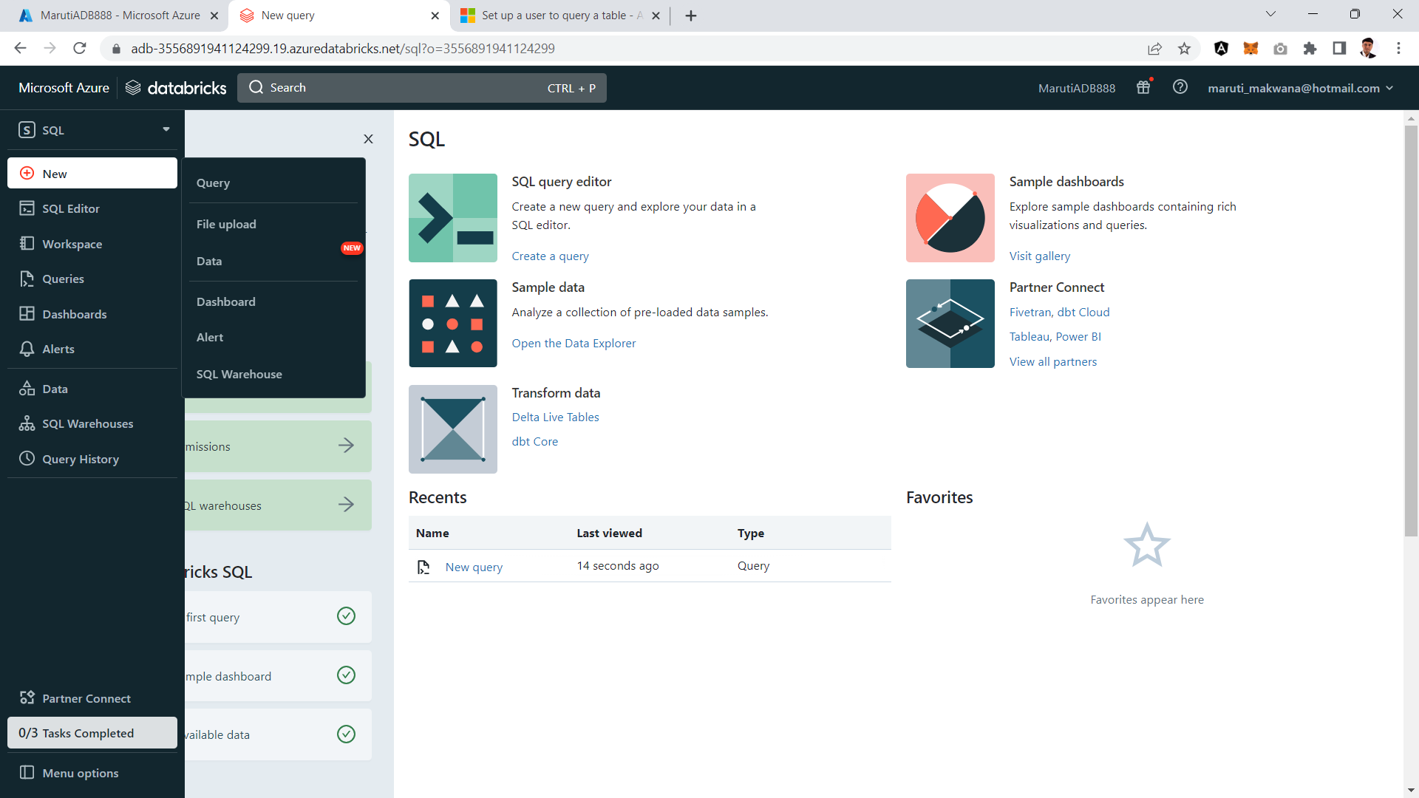

Slide 4
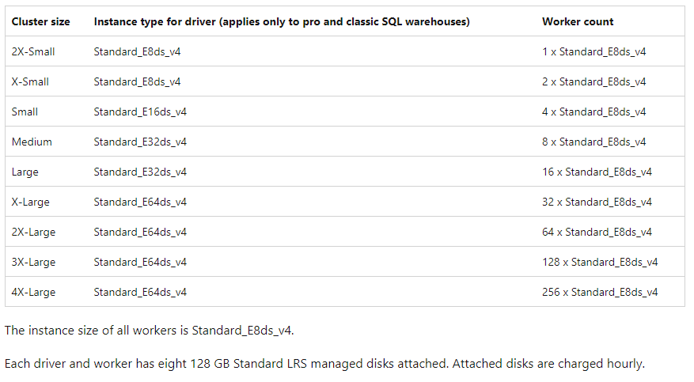

Slide 5
What is Serverless SQL pool?
Serverless SQL for Azure Databricks, a new capability for Azure Databricks SQL, provides instant compute to users for their BI and SQL workloads, with minimal management required and capacity optimizations that can lower overall cost. You only pay for Serverless SQL when users start running reports or queries.
Serverless SQL was built for the modern business analyst who works on their own schedules and wants instant compute available to process their queries without waiting for clusters to start up or scale out.
Serverless SQL warehouses use compute clusters in the customer’s Databricks account. Use serverless SQL warehouses with Databricks SQL queries the same way you would with the original customer-hosted SQL warehouses, which are now called classic SQL warehouses.

Slide 6
Azure Databricks operates out of a control plane and a data plane:
The control plane includes the backend services that Azure Databricks manages in its own Azure subscription. Databricks SQL queries, notebook commands, and many other workspace configurations are stored in the control plane and encrypted at rest.
The data plane is where data is processed by clusters of compute resources.
There are important differences between the classic data plane (the original Azure Databricks platform architecture) and the serverless data plane:
For a classic data plane, Azure Databricks compute resources run in the customer’s Azure subscription. Clusters perform distributed data analysis using queries (in Databricks SQL) or notebooks (in the Data Science & Engineering or Databricks Machine Learning environments):
New clusters are created within each workspace’s virtual network in the customer’s Azure subscription.
A classic data plane has natural isolation because it runs in each customer’s own Azure subscription. A classic data plane is not a shared resource for multiple customers.
For a serverless data plane, Azure Databricks compute resources run in a special compute layer within the Azure subscription for Azure Databricks:
The serverless data plane is used for serverless SQL warehouses and Model Serving. Enabling serverless compute does not change how Databricks Runtime clusters work in the Data Science & Engineering or Databricks Machine Learning environments.
The serverless data plane is a shared resource in your Azure Databricks account.
To protect customer data within the serverless data plane, serverless compute runs within a network boundary for the workspace, with various layers of security to isolate different Azure Databricks customer workspaces and additional network controls between clusters of the same customer.
Azure Databricks creates a serverless data plane in the same Azure region as your workspace’s classic data plane.

Slide 7
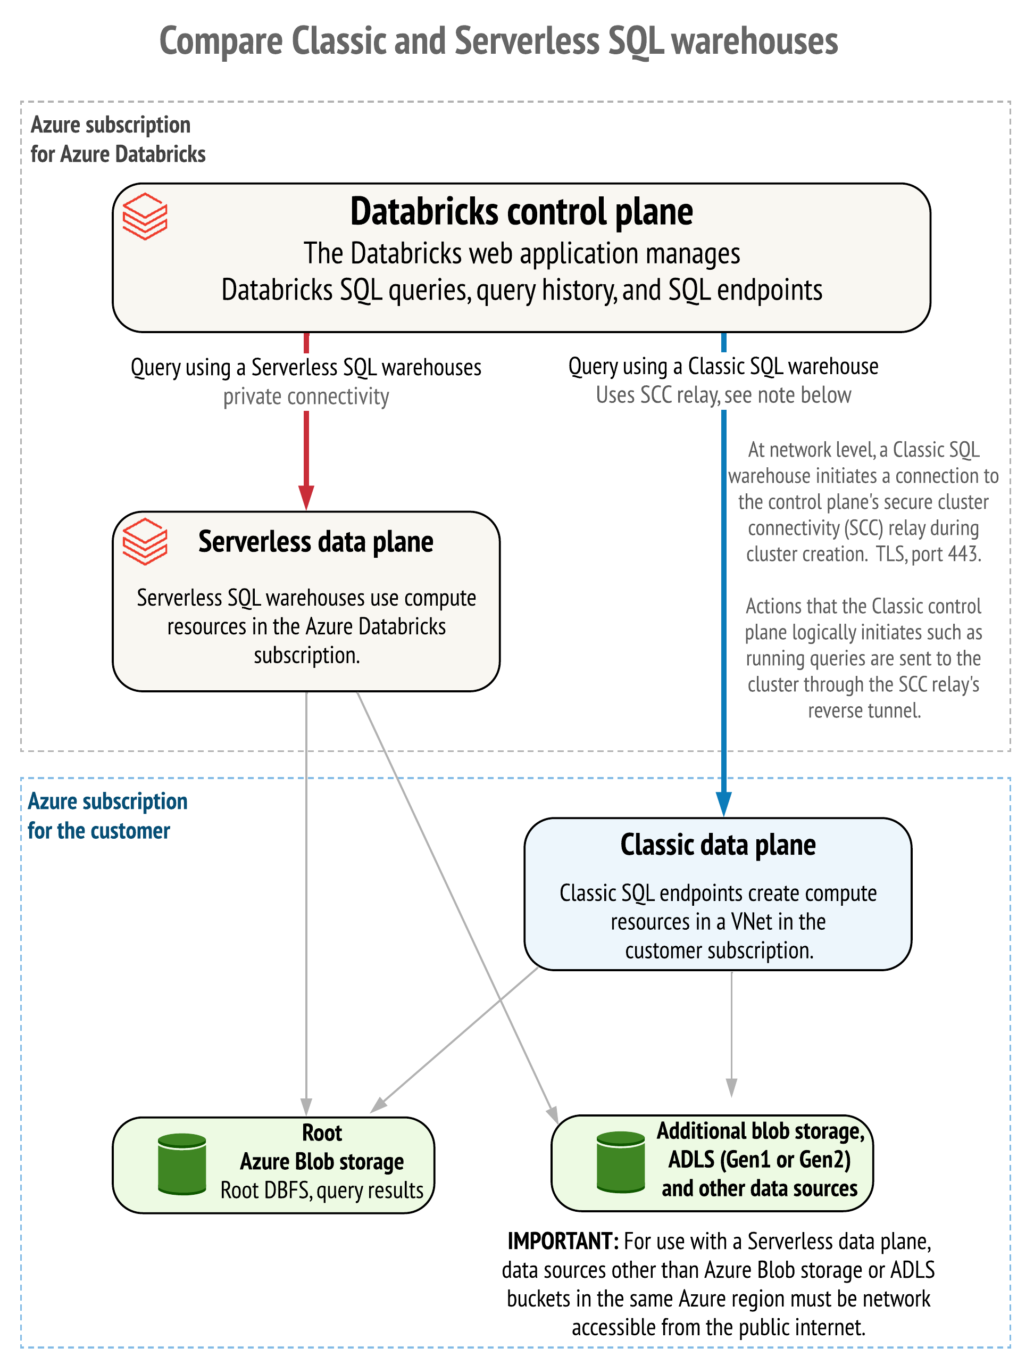
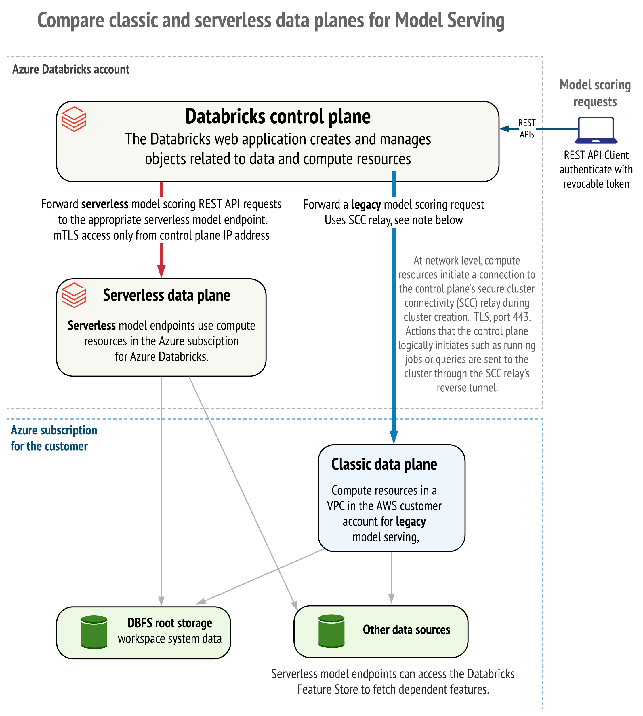

Slide 8
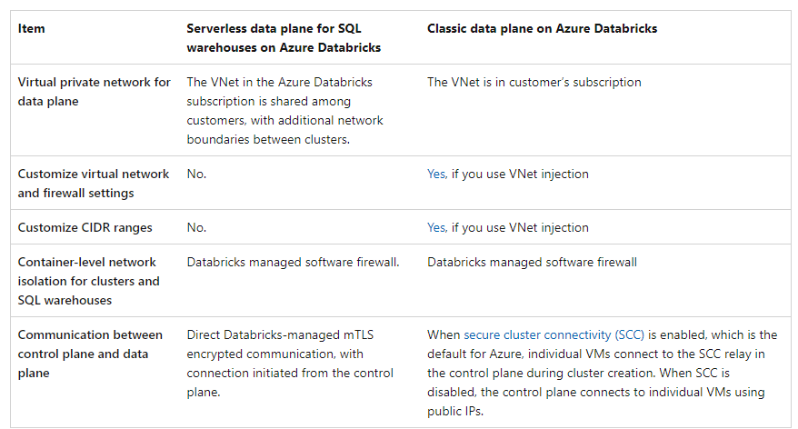
https://learn.microsoft.com/en-gb/azure/databricks/serverless-compute/

Slide 9
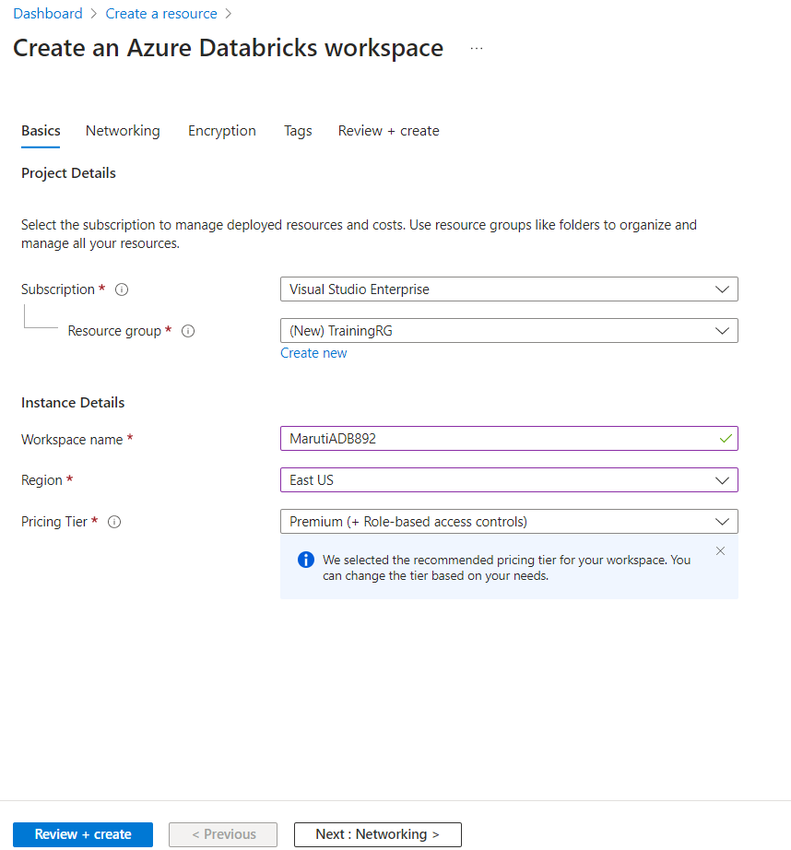

Slide 10
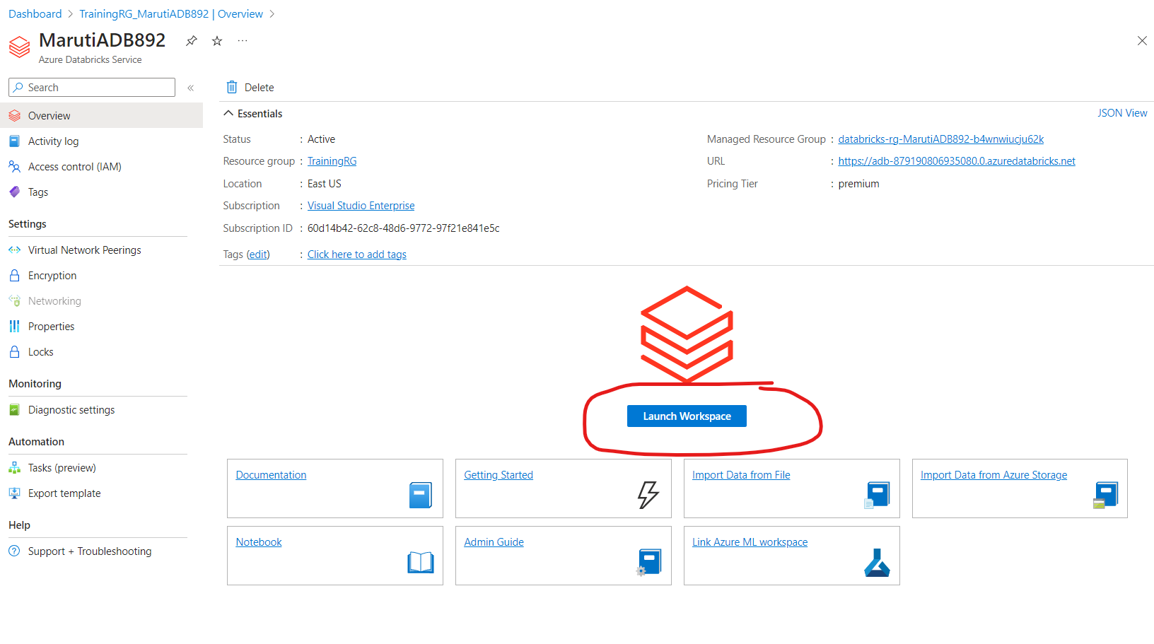

Slide 11
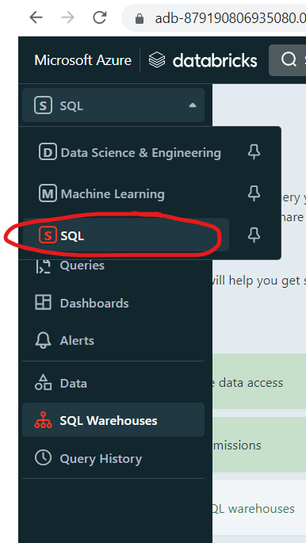

Slide 12
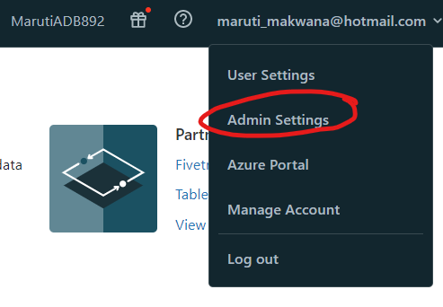

Slide 13
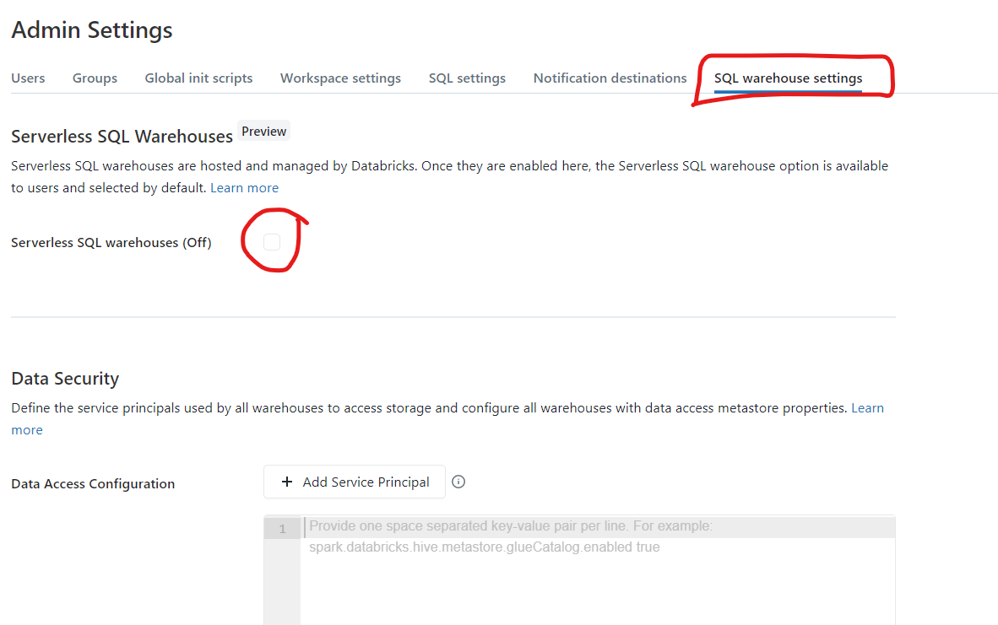

Slide 14


Slide 16
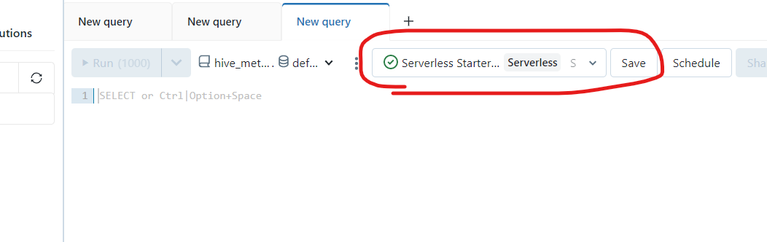

Slide 17
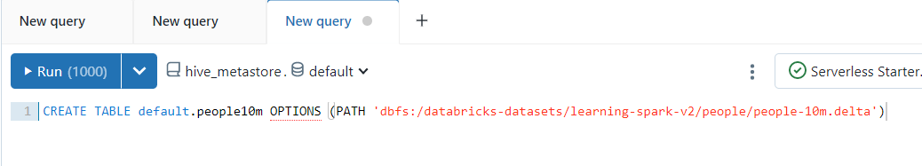
CREATE TABLE default.people10m OPTIONS (PATH 'dbfs:/databricks-datasets/learning-spark-v2/people/people-10m.delta')

Slide 18
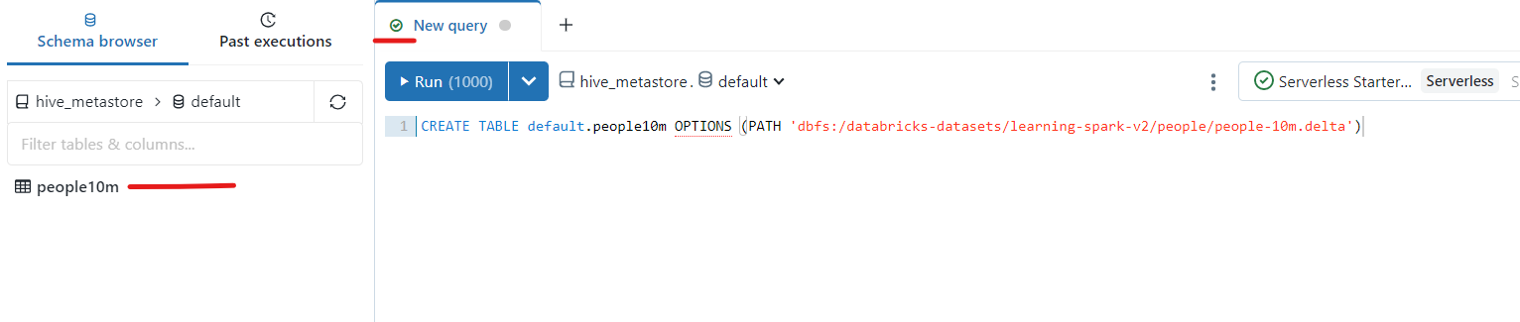

Slide 19
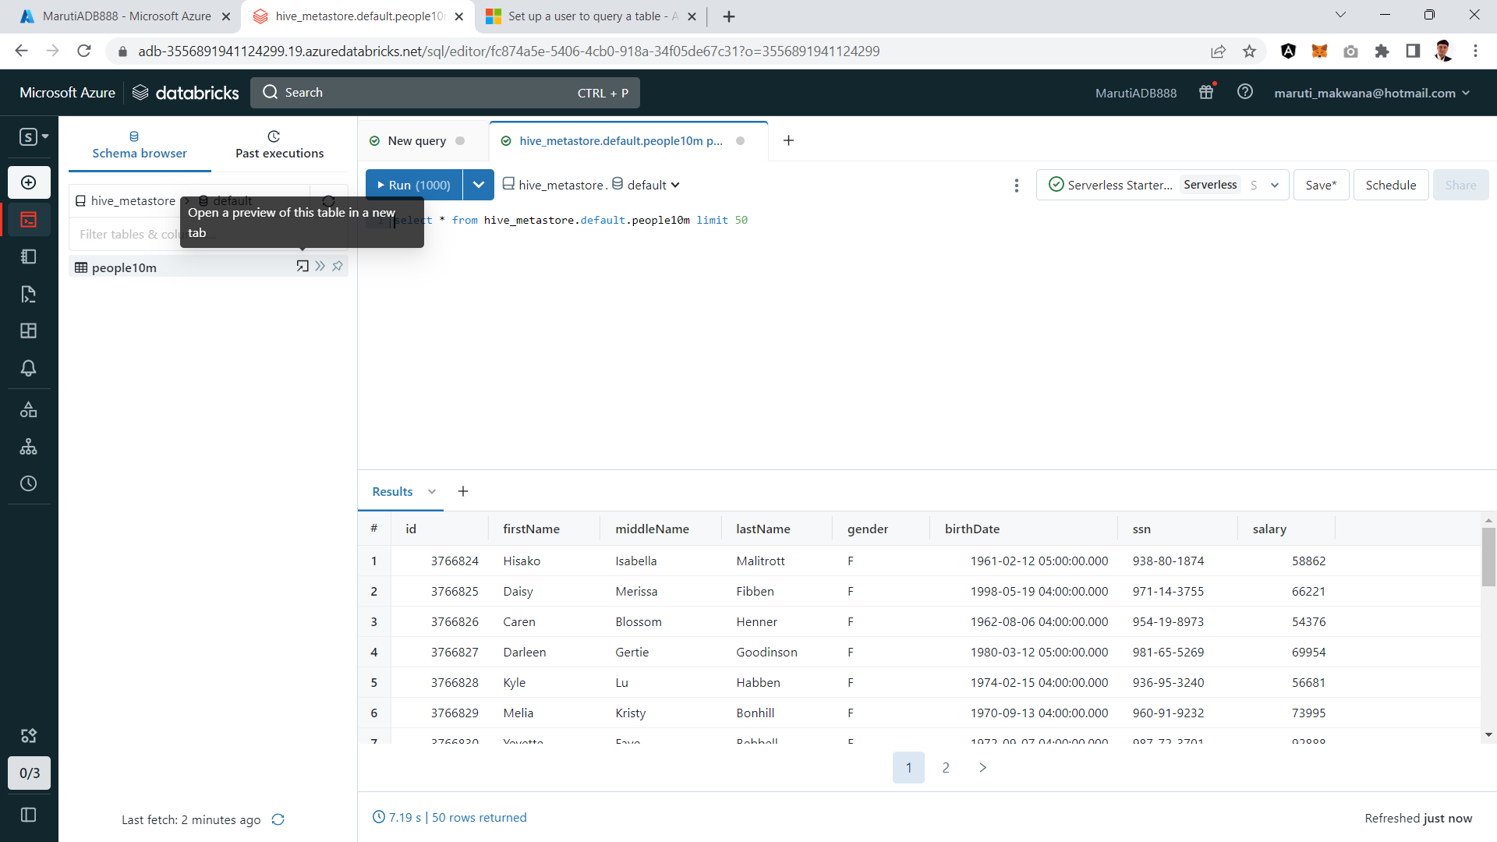

Slide 20
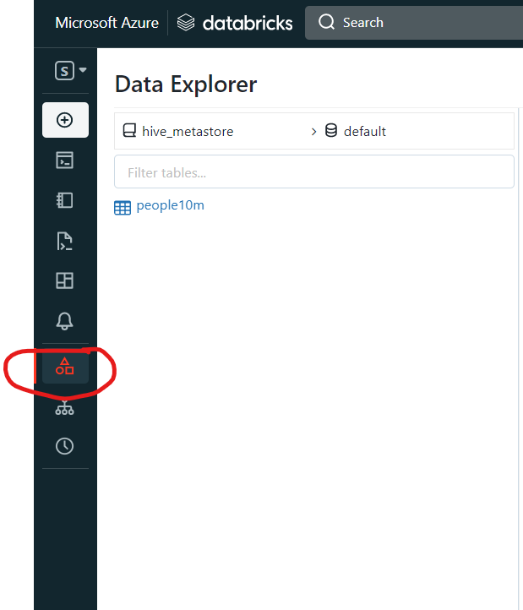

Slide 21
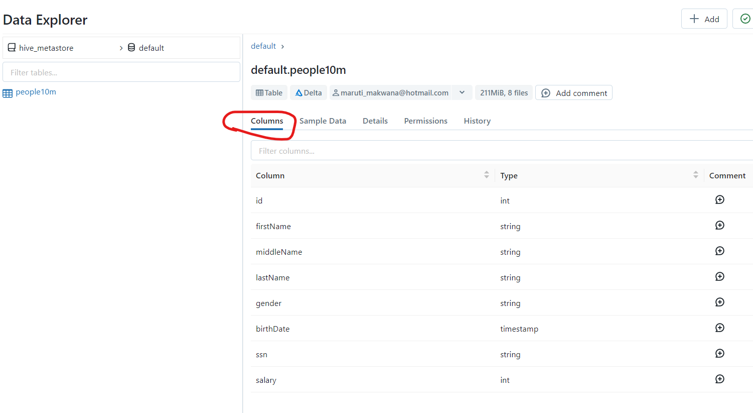

Slide 22
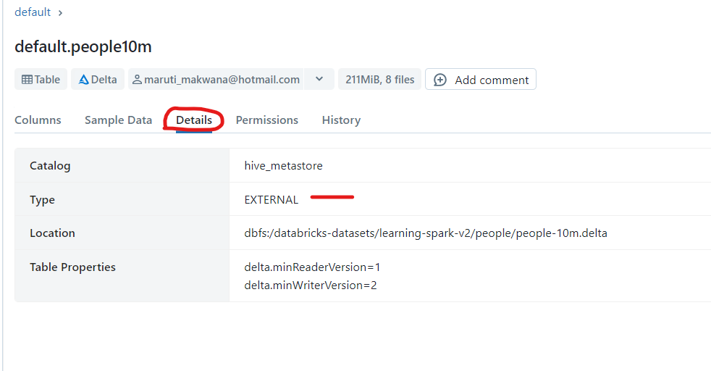

Slide 23
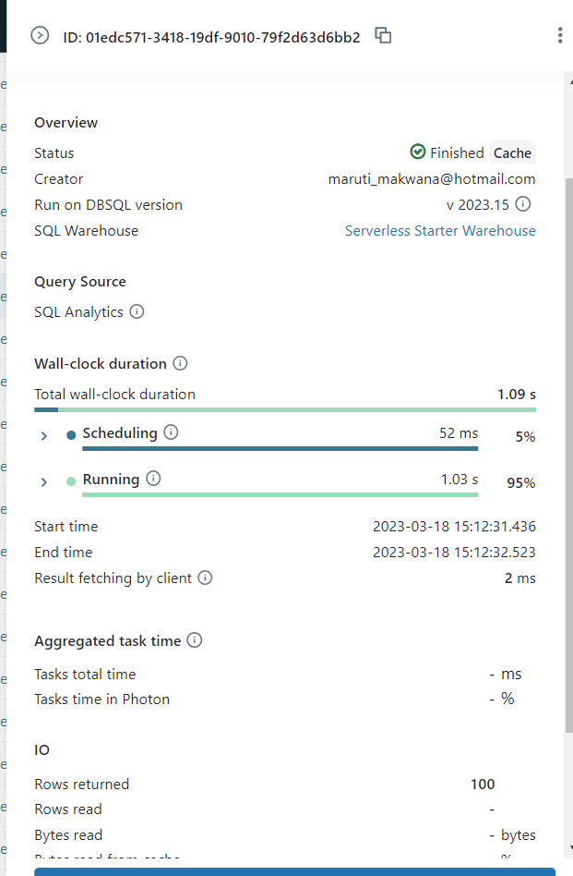
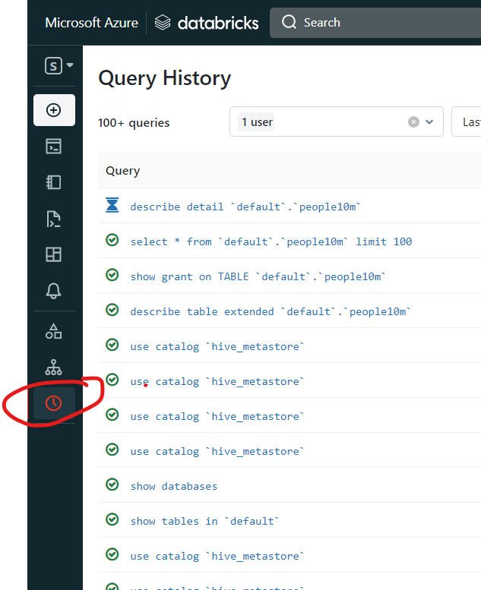
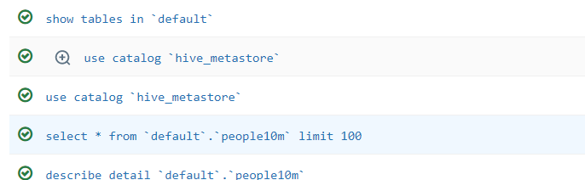

Slide 24
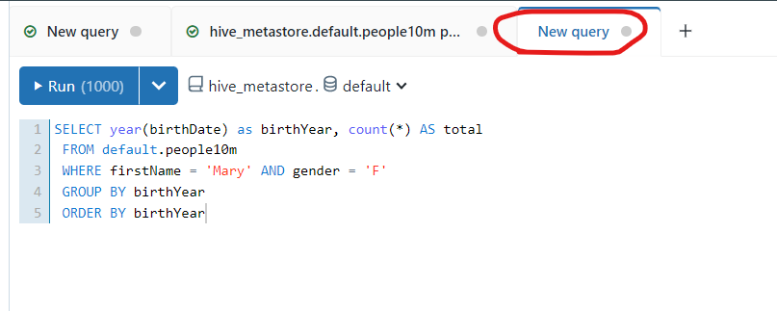
SELECT year(birthDate) as birthYear, count(*) AS total
FROM default.people10m
WHERE firstName = 'Mary' AND gender = 'F'
GROUP BY birthYear
ORDER BY birthYear

Slide 25
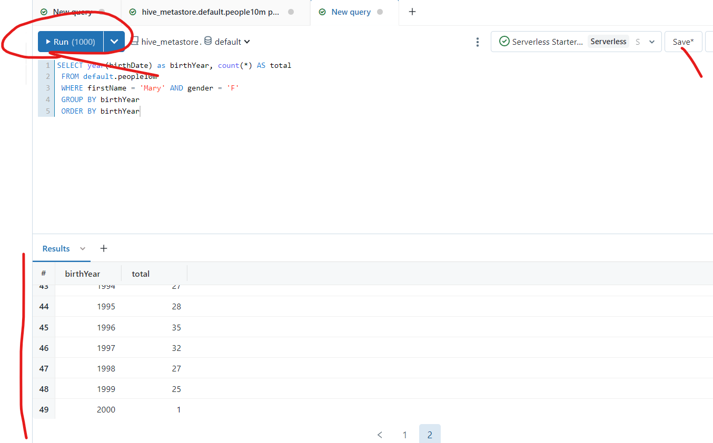

Slide 26
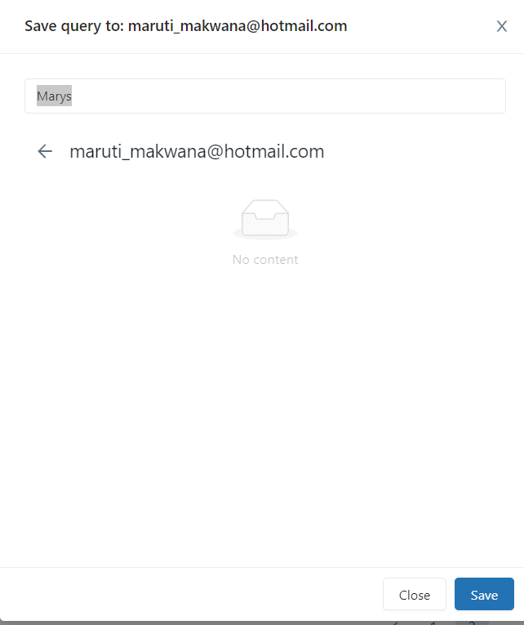

Slide 27
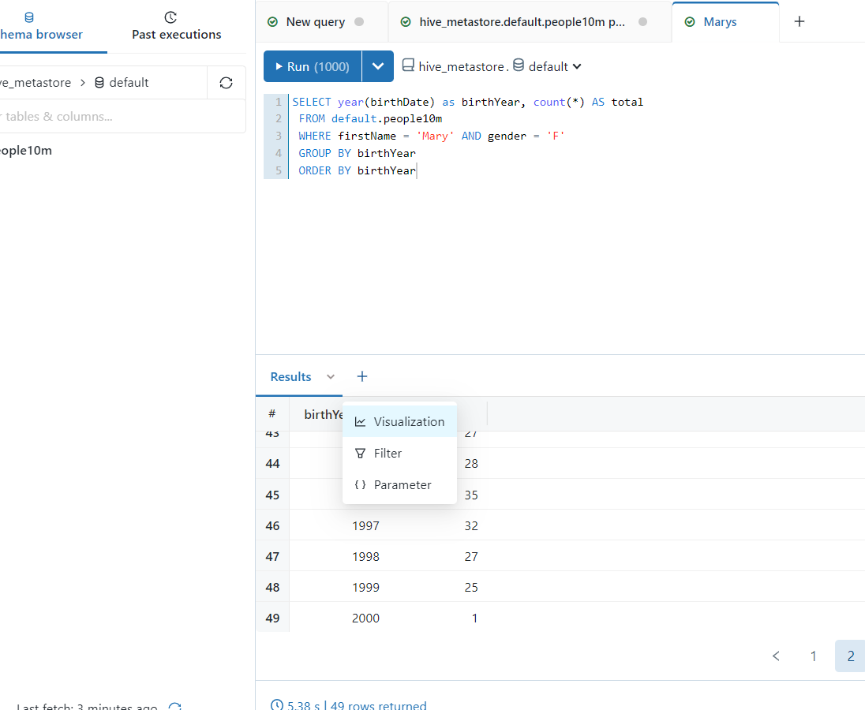

Slide 28
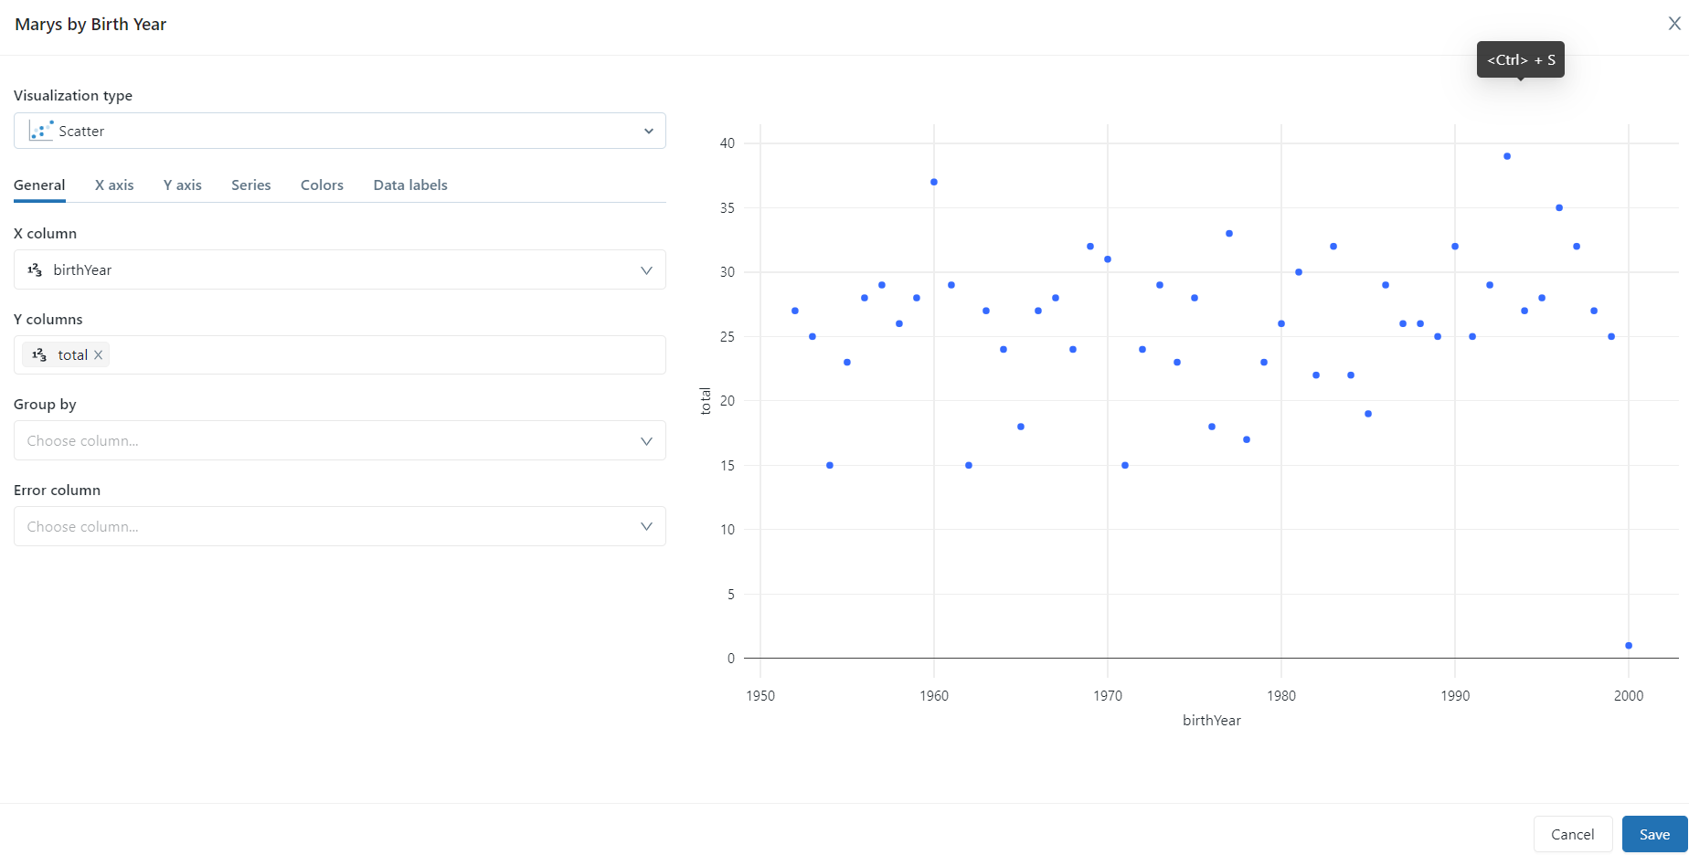

Slide 29
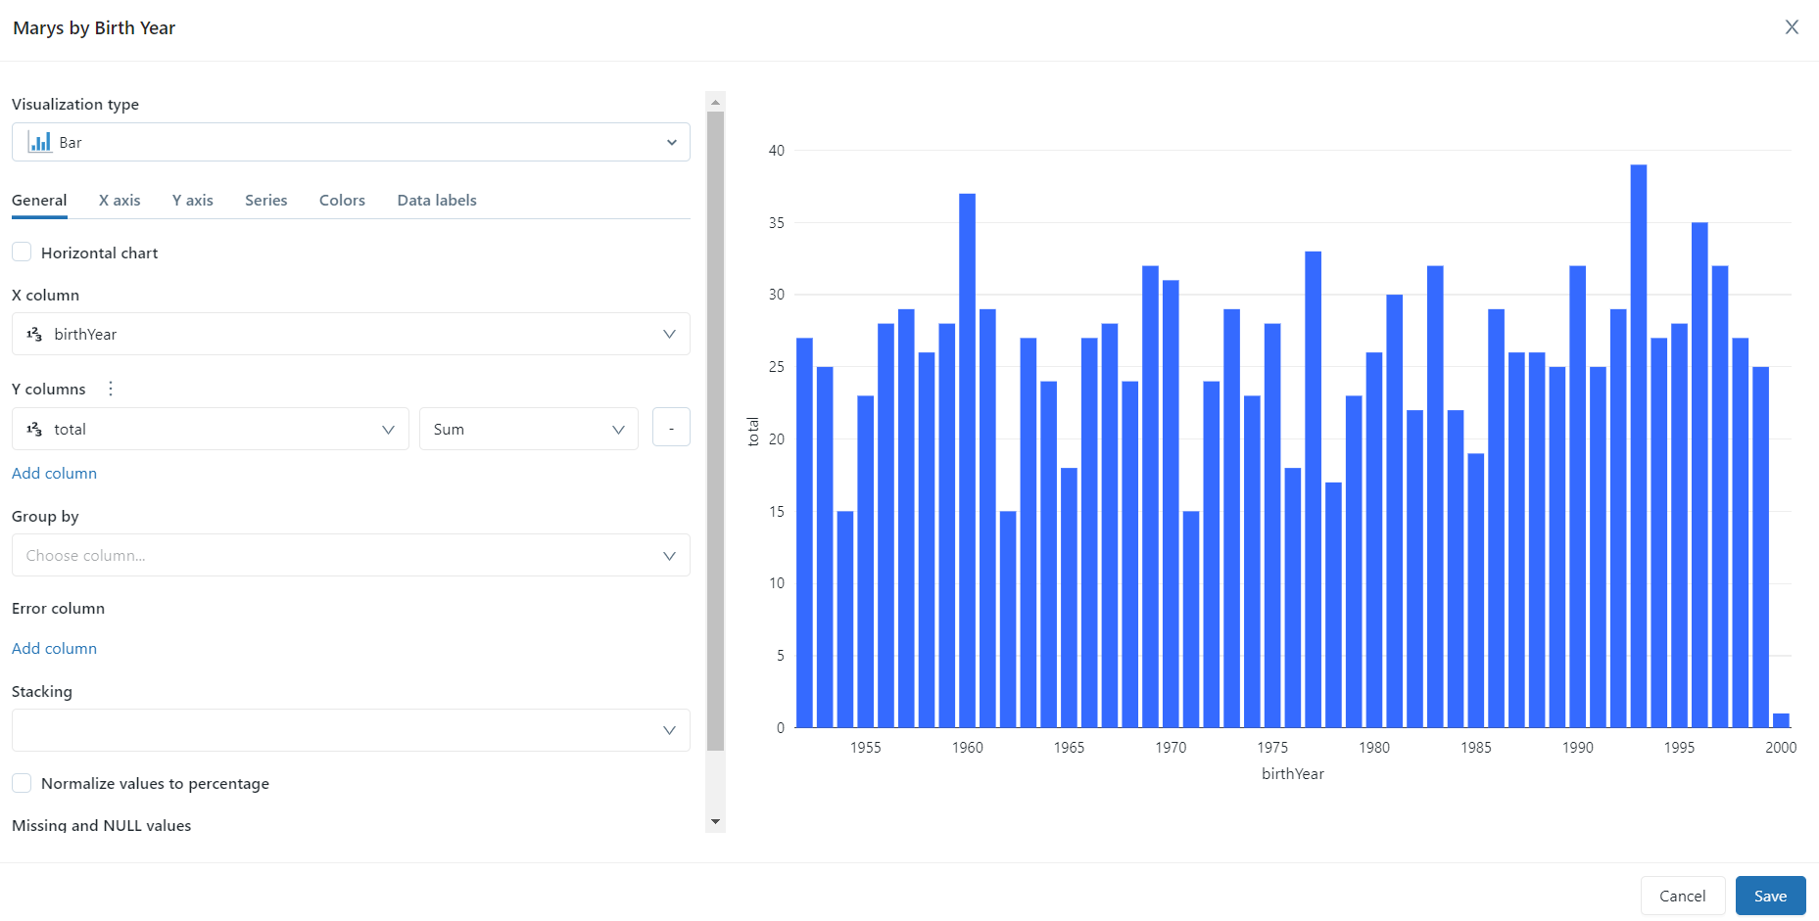
Save this

Slide 30
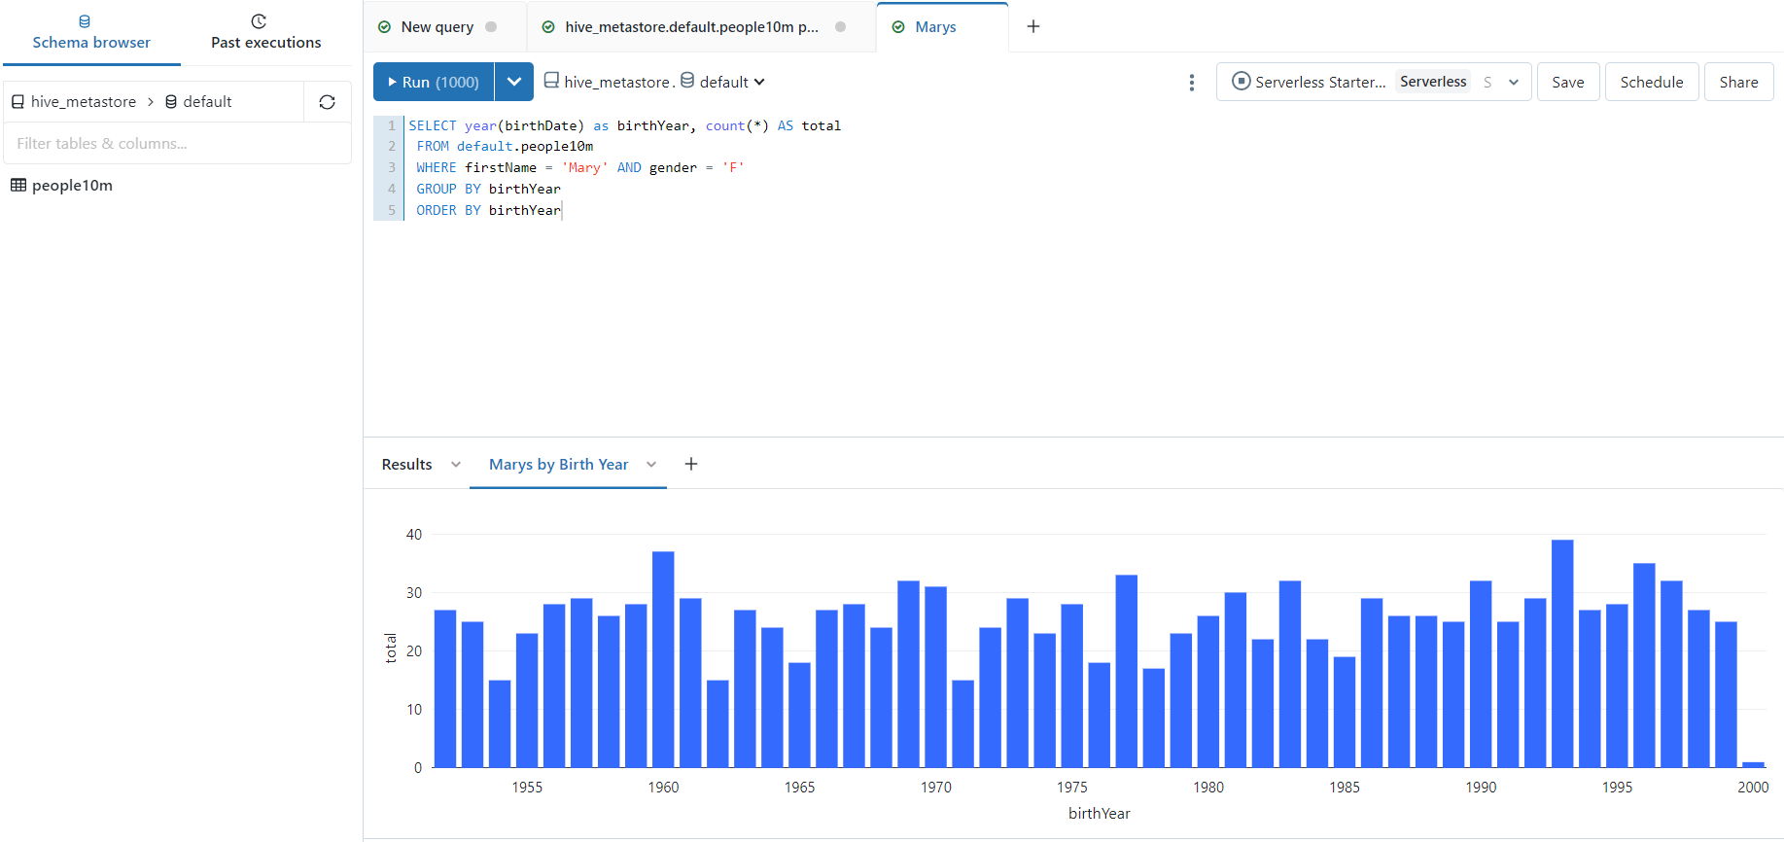

Slide 31
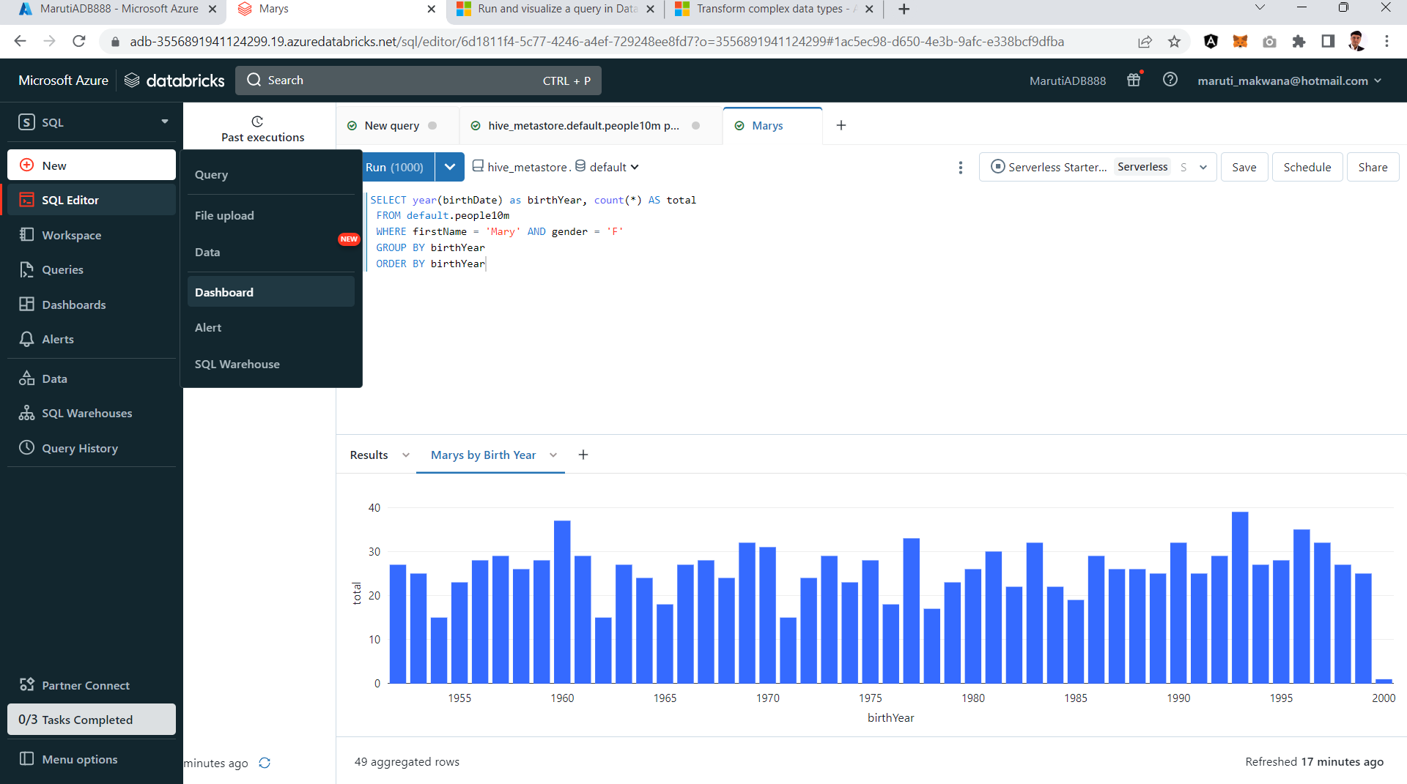
Click on dashboard

Slide 32
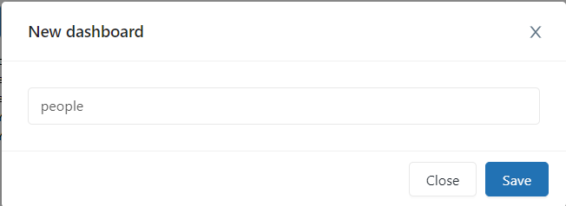

Slide 33
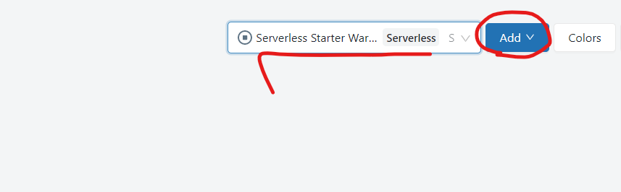
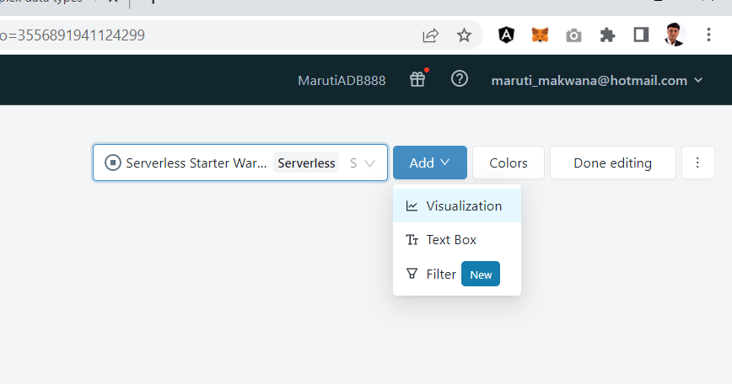

Slide 34
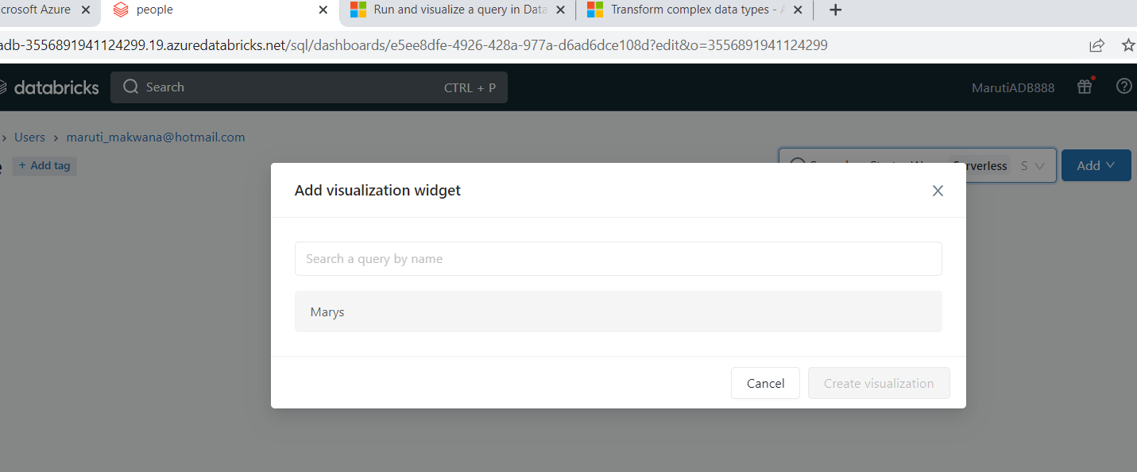
Select marys

Slide 35
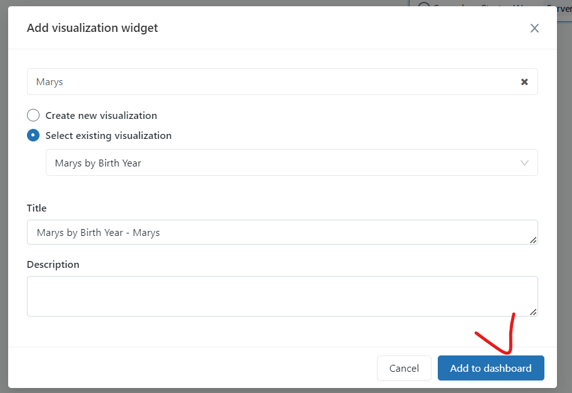

Slide 36
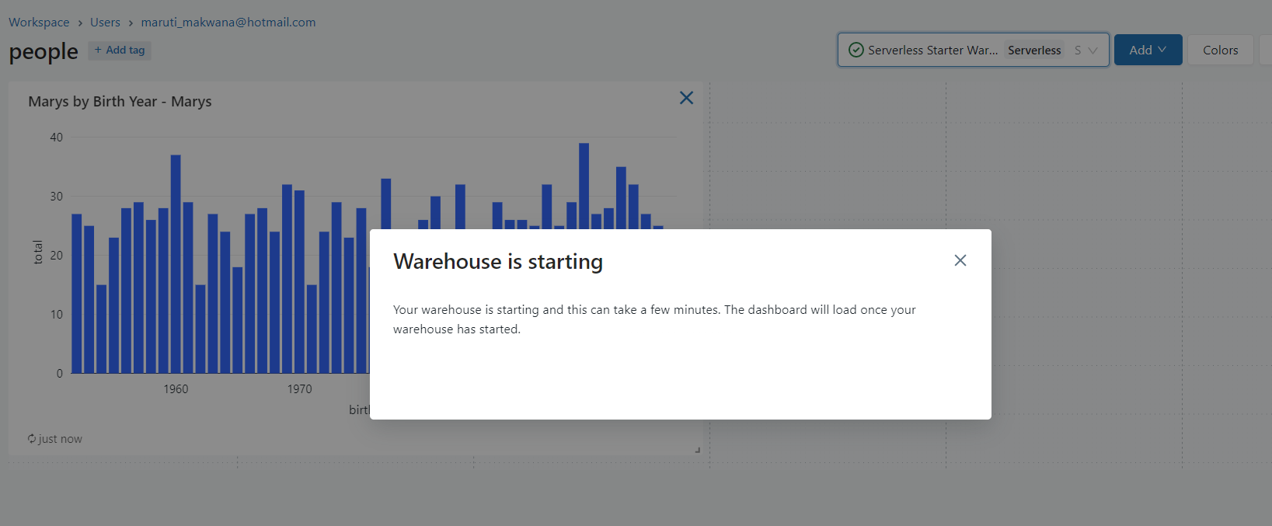

Slide 37
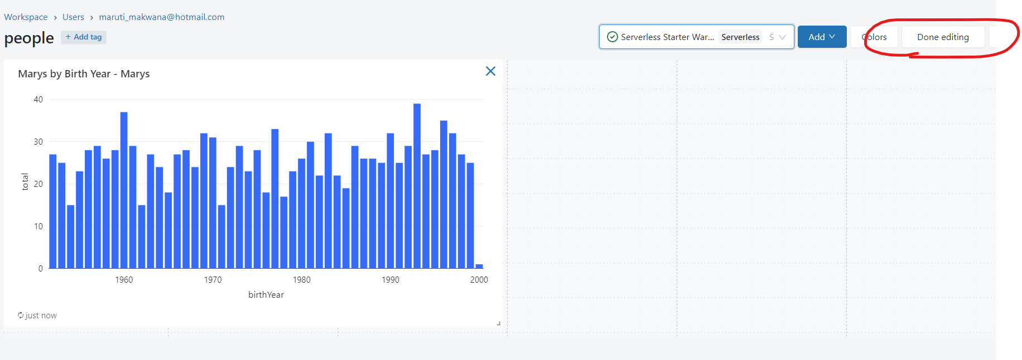

Slide 38
Now lets try to associate this with ADLS Gen2
https://learn.microsoft.com/en-us/azure/databricks/ingestion/copy-into/tutorial-dbsql?source=recommendations

Slide 39
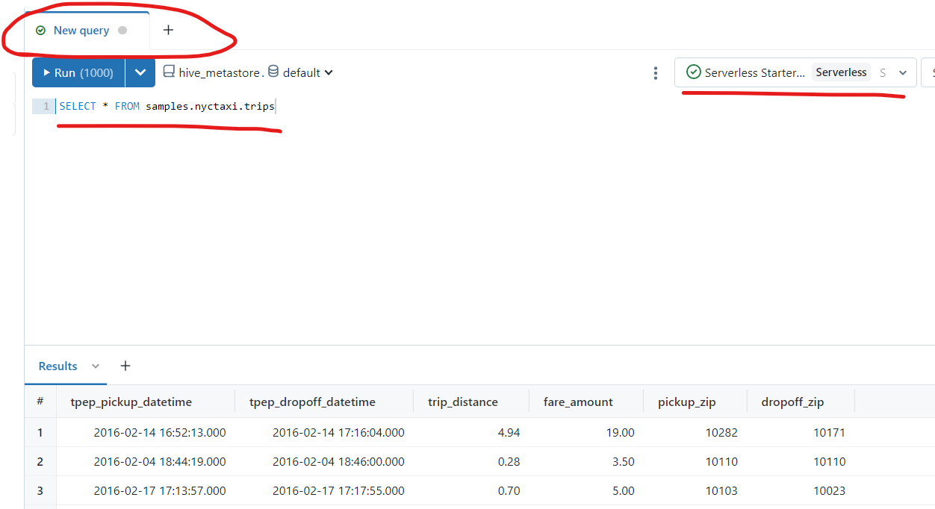
SELECT * FROM samples.nyctaxi.trips

Slide 40
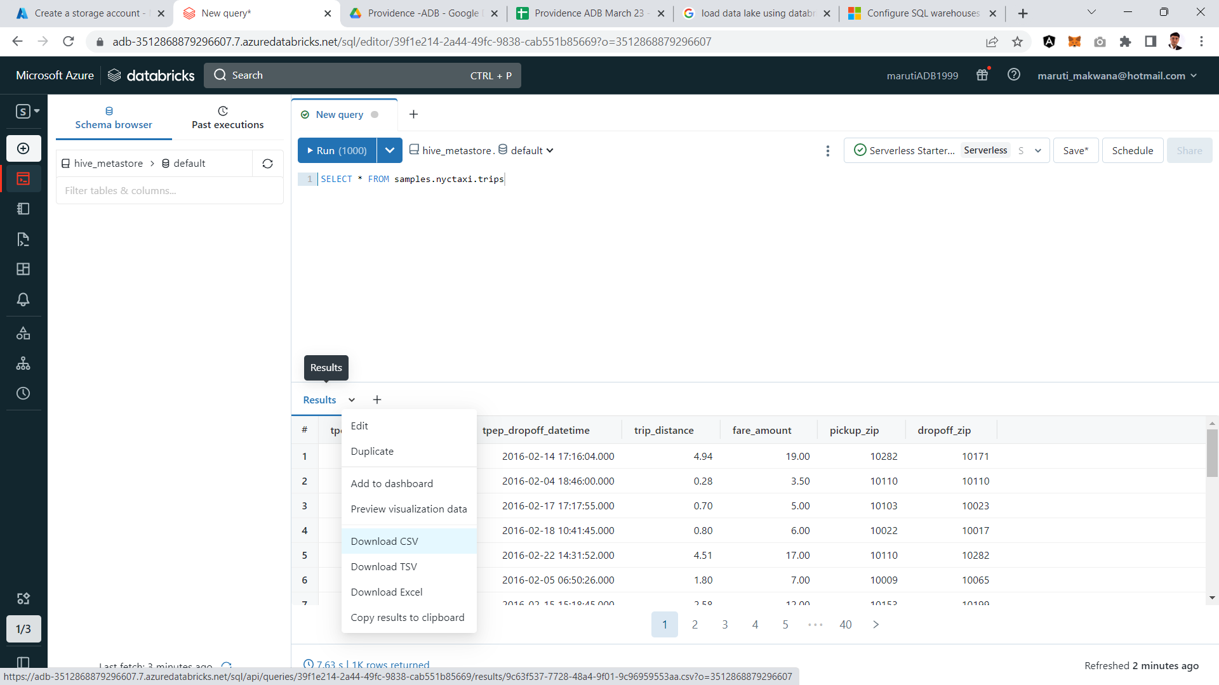

Slide 41
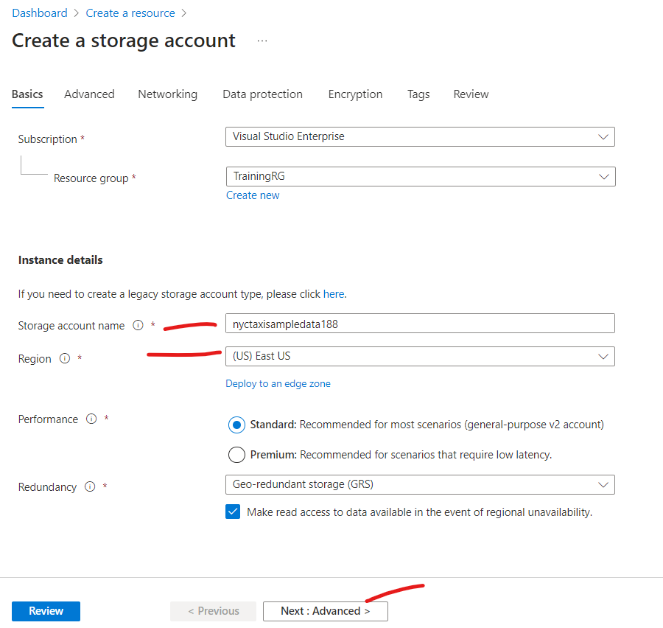

Slide 42
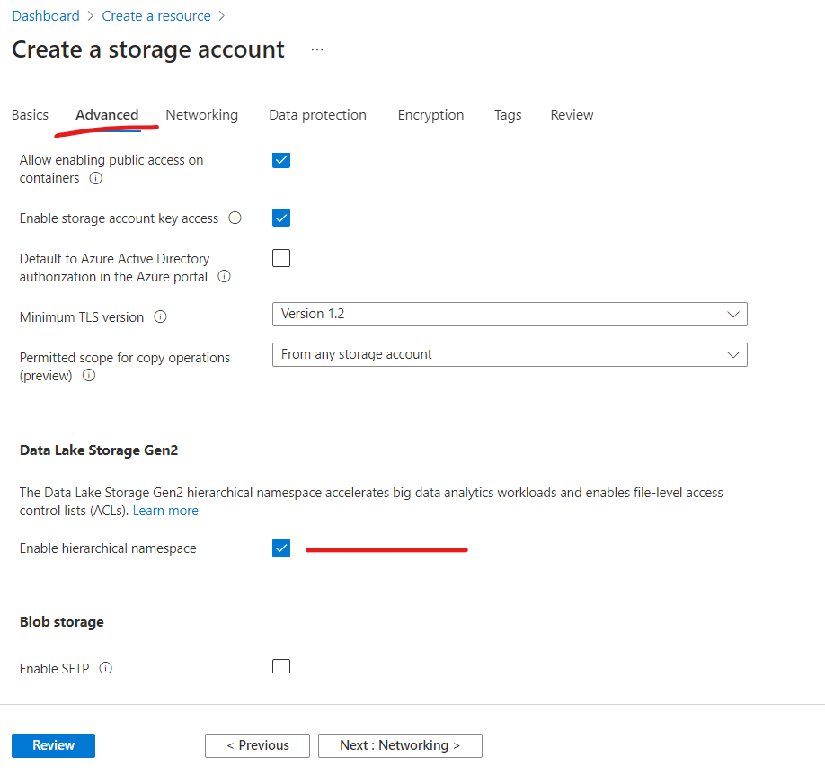

Slide 43
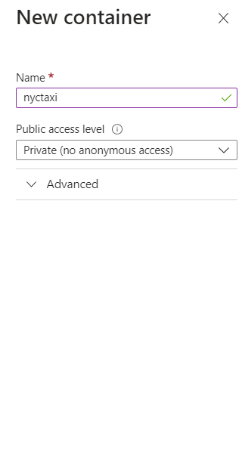

Slide 44
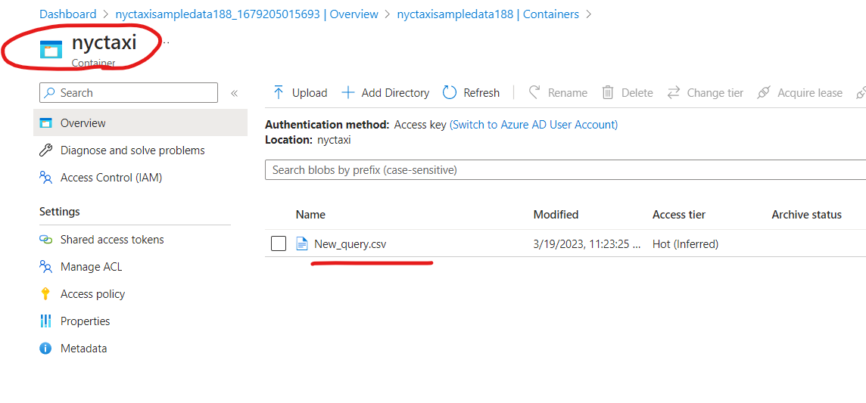

Slide 45
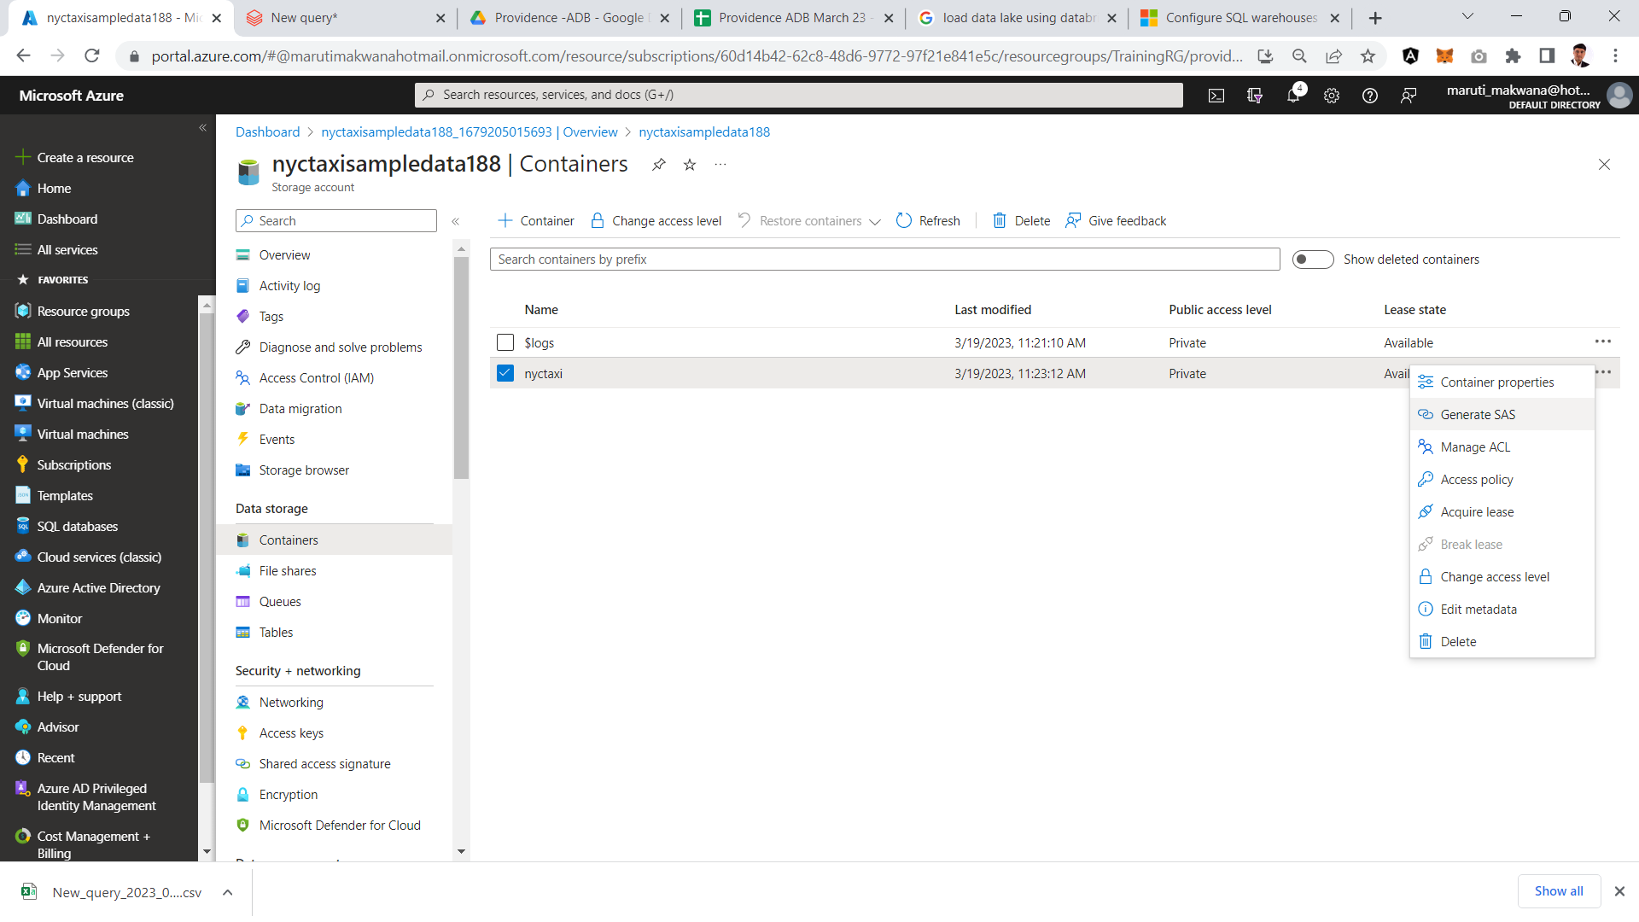

Slide 46
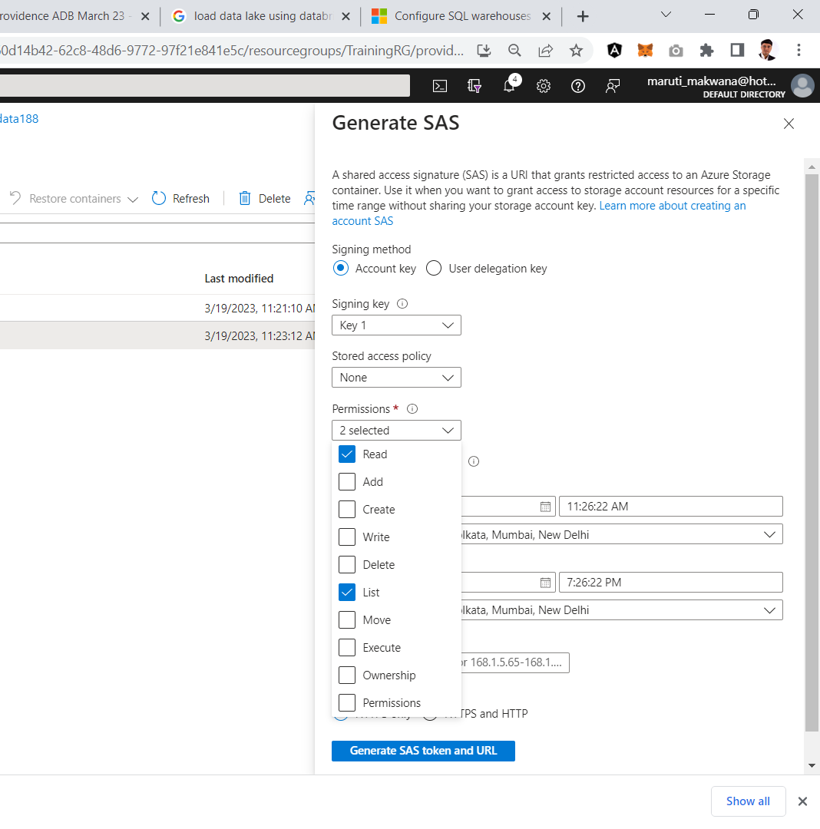

Slide 47
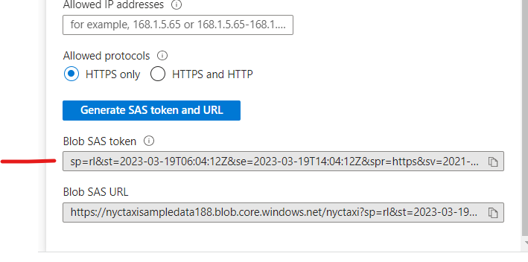
sp=rl&st=2023-03-19T06:04:12Z&se=2023-03-19T14:04:12Z&spr=https&sv=2021-12-02&sr=c&sig=NSqiCB2F%2FfB%2FrMCJGZGvpe6CiJCMRsC3uR6MnoTDOtI%3D

Slide 48
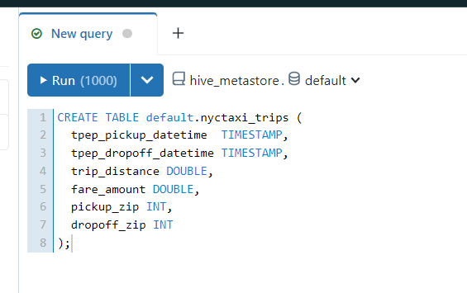
CREATE TABLE default.nyctaxi_trips (
tpep_pickup_datetime TIMESTAMP,
tpep_dropoff_datetime TIMESTAMP,
trip_distance DOUBLE,
fare_amount DOUBLE,
pickup_zip INT,
dropoff_zip INT
);

Slide 49
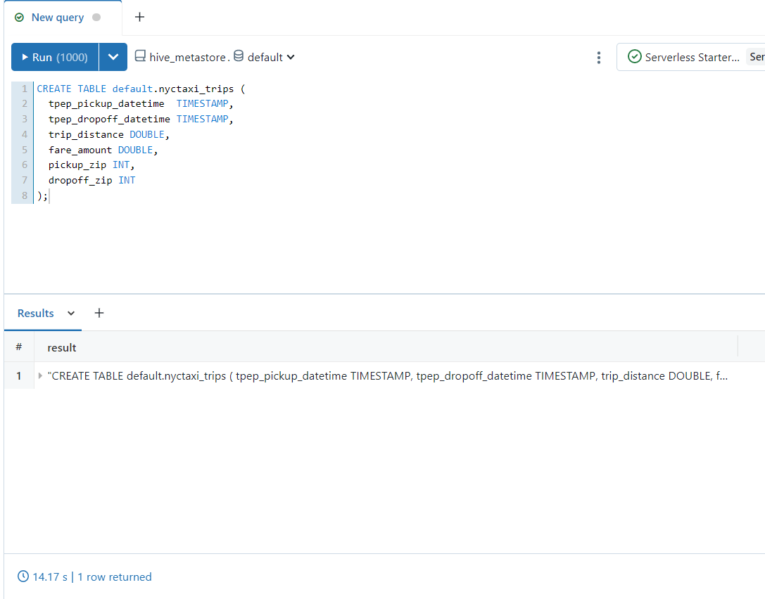

Slide 50
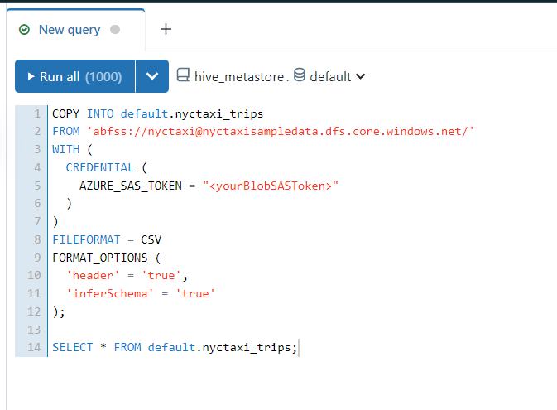

Slide 51
COPY INTO default.nyctaxi_trips
FROM 'abfss://nyctaxi@nyctaxisampledata.dfs.core.windows.net/'
WITH (
CREDENTIAL (
AZURE_SAS_TOKEN = "<yourBlobSASToken>"
)
)
FILEFORMAT = CSV
FORMAT_OPTIONS (
'header' = 'true',
'inferSchema' = 'true'
);
SELECT * FROM default.nyctaxi_trips;

Slide 52
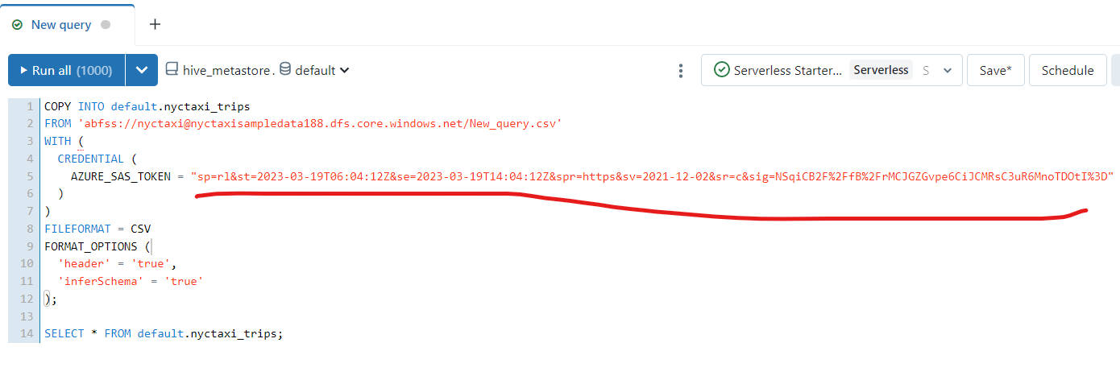

Slide 53
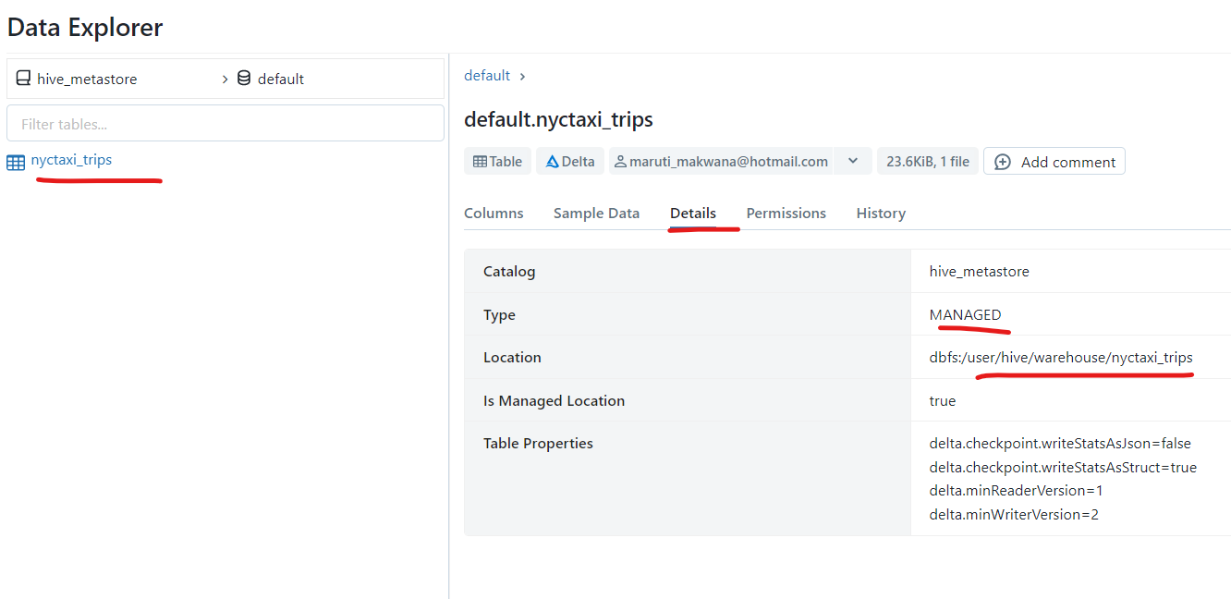

Slide 54
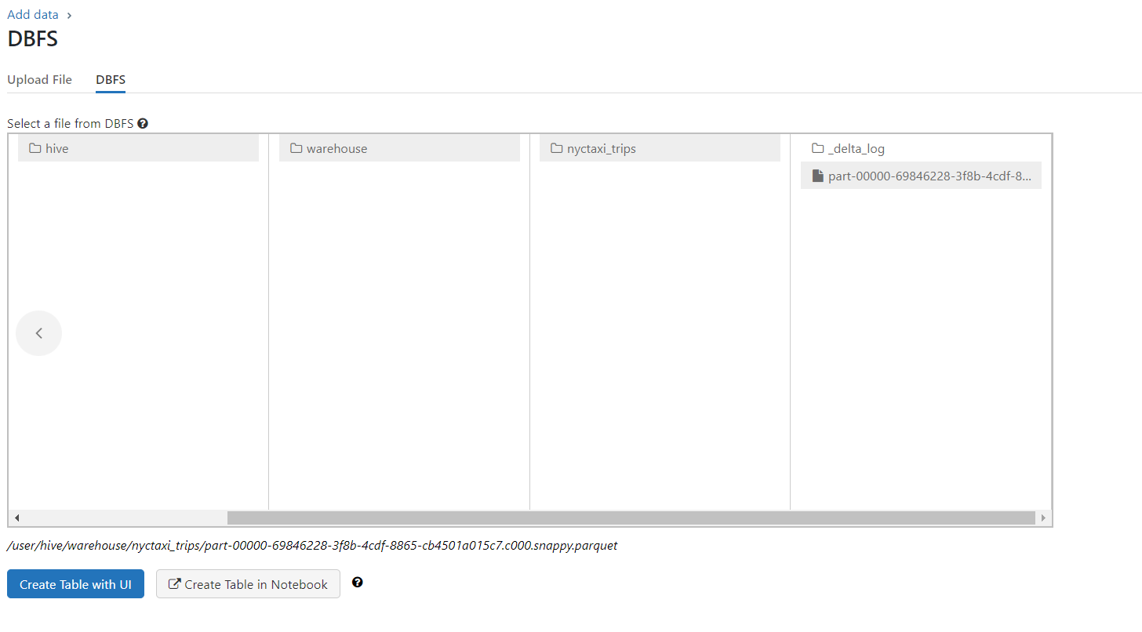

Slide 59
Azure Shared Responsibility Model

Slide 60
Azure Shared Responsibility Model

Slide 61
Azure Shared Responsibility Model

